Slide 1


Hackacitizens

Slide 2

Our Idea
Mobility Index for Bus Stops Using Wi-Fi Data with POI Features
WiFi Access Data as a proxy for Mobility
Train an ML model to predict a Mobility Index based on Geospatial Features (Points of Interest)
Nearby Schools, Hospitals, Tourist Attractions
Use this learning from AP to Predict expected Mobility for Bus Stops
Match available buses with expected mobility to optimize public transportation

Slide 3

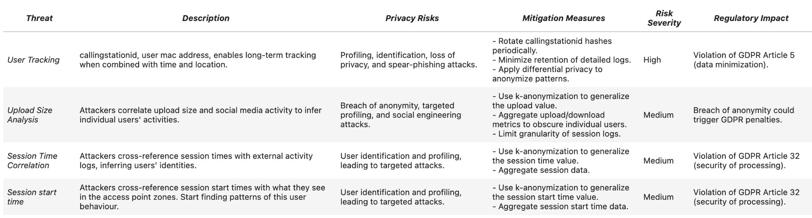
Security Risk Assessment
Framework: Privacy Impact Assessment (PIA)

Slide 4

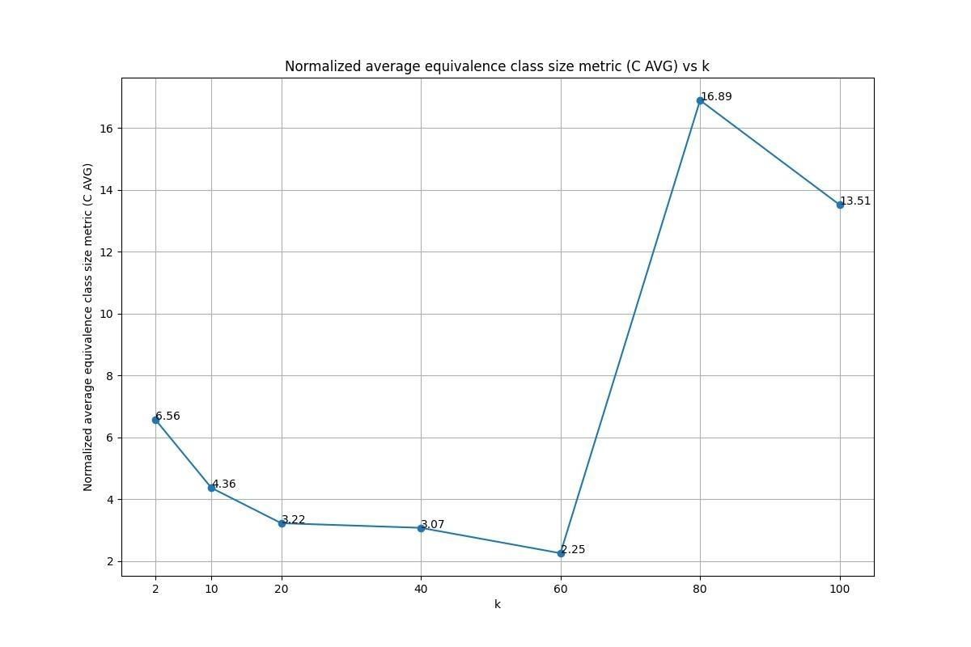
Privacy Measures
Most relevant measures:
MAC Address Hashing
Implicitely enable Right to be Forgotten
Hide sensitive PII
k-Anonymization (Mondrian, K=60)
upload, session time
Differential Privacy (epsilon = 0.5)
on wifi aggregated accesses

Slide 5

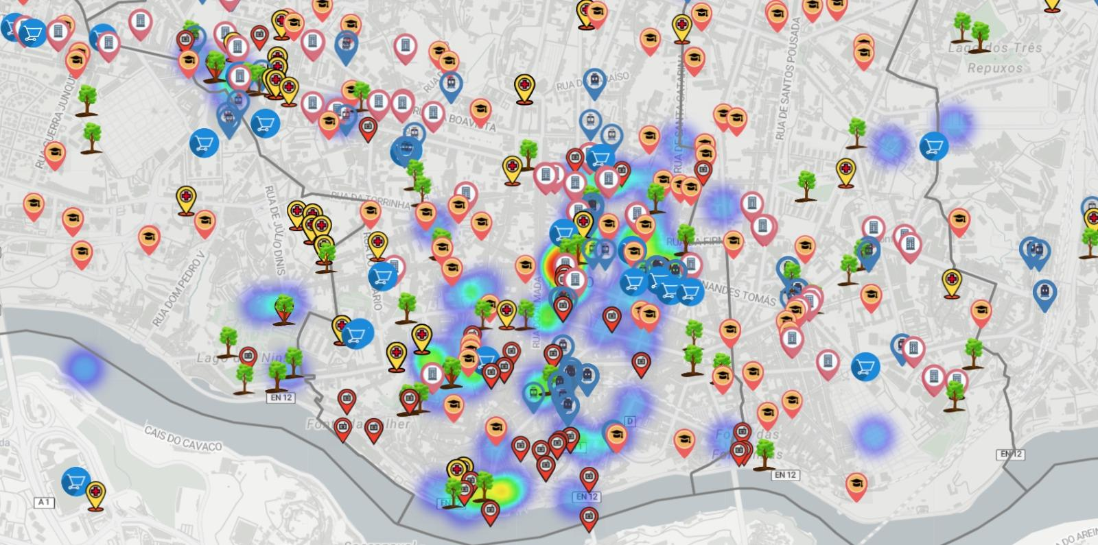
Data Used for Mobility Index (Training)
Hotspots map and POIs in Porto city

Slide 6

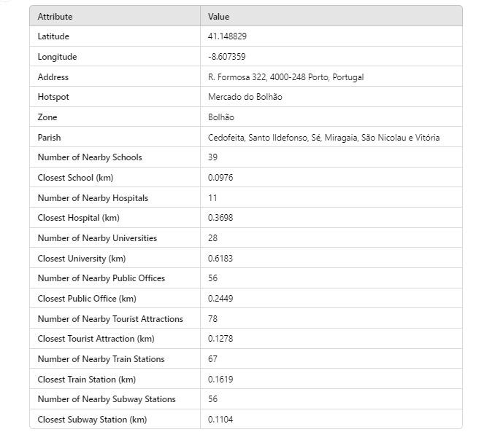


Data Used for Mobility Index (Training)
GeoSpatial - Points of Interest in Hotspots surroundings

Slide 7
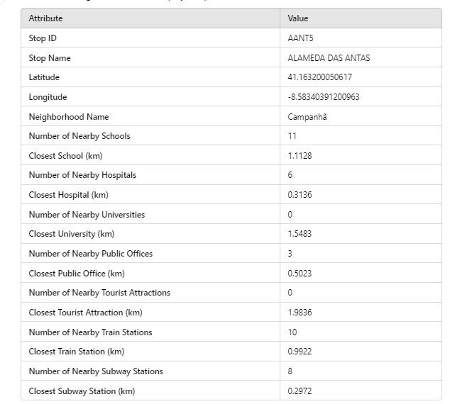

Mobility Index (Inference Table)
POI in the surroundings of bus stops

Slide 8
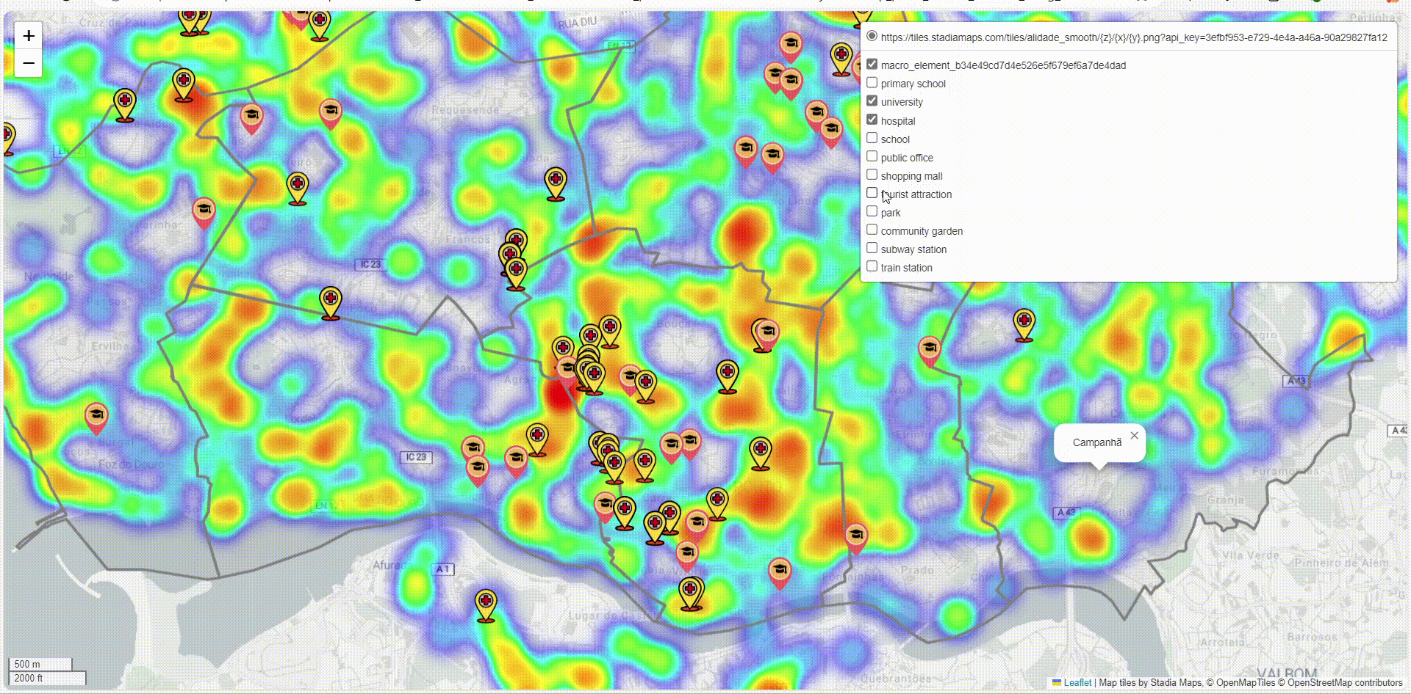
Mobility Index (Inference)
Heat map bus stops across Porto city in relation to POIs

Slide 9

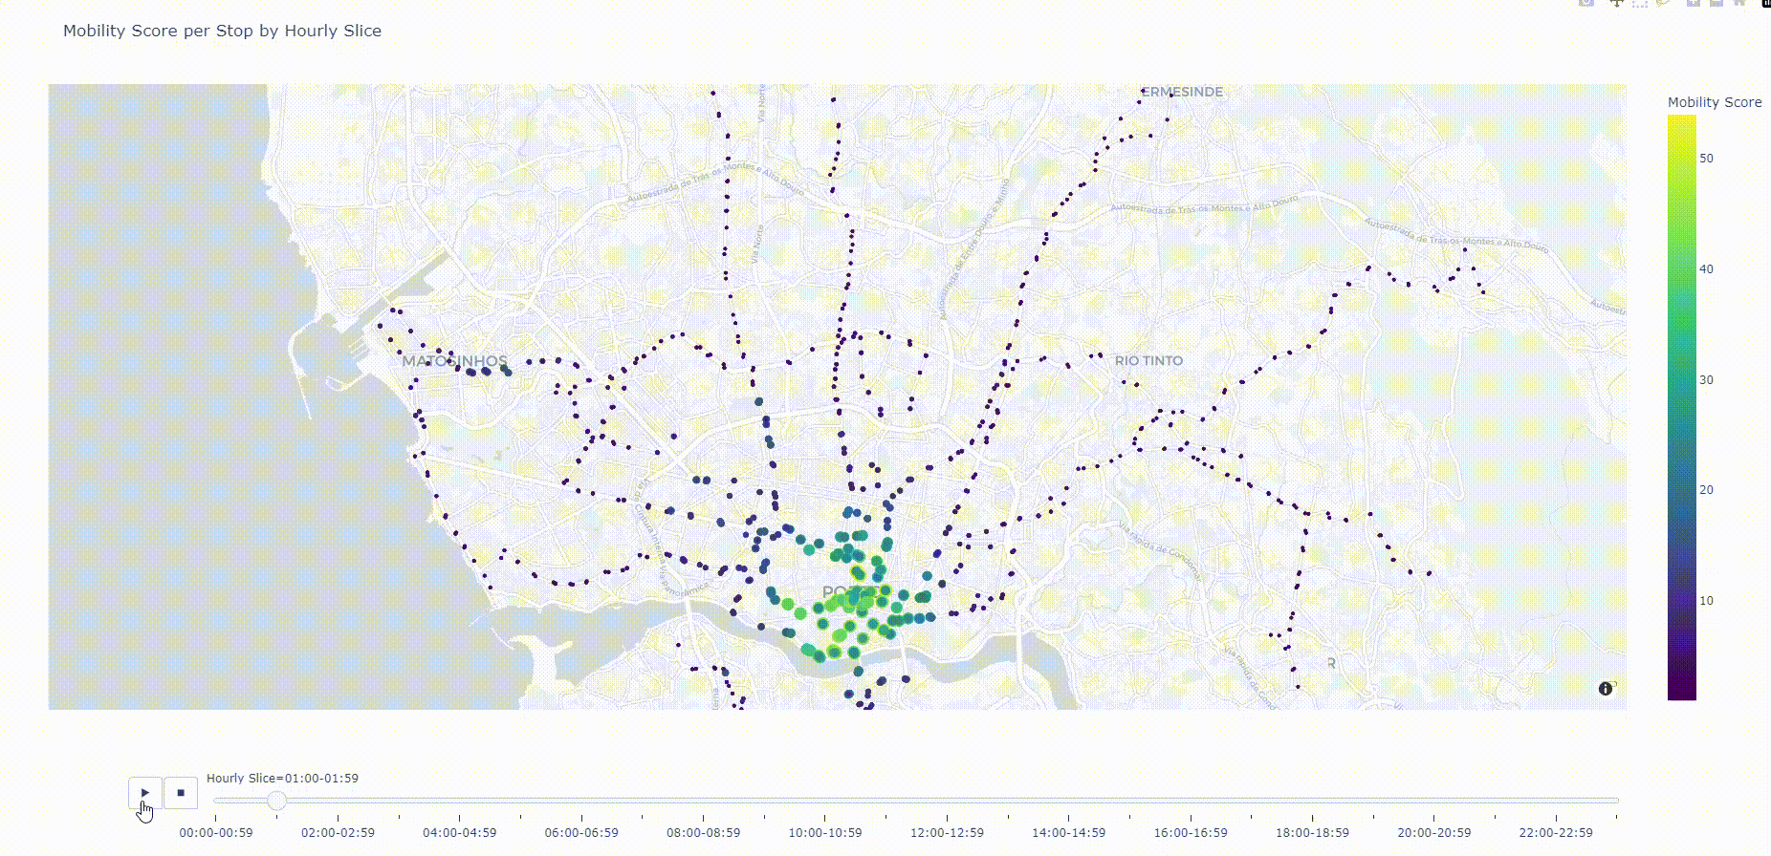
Predictive Model Output
(extrapolate AP-hotspots learning)

Slide 10

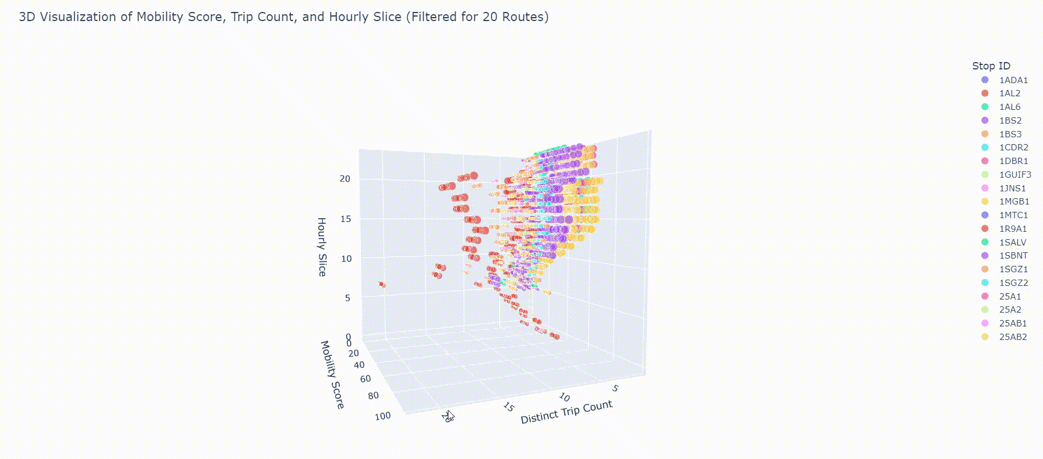
Impact & Opportunities

Slide 11
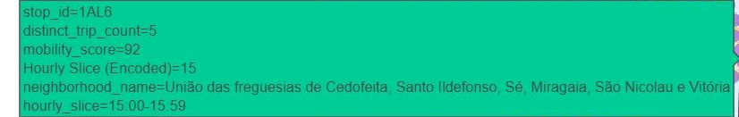
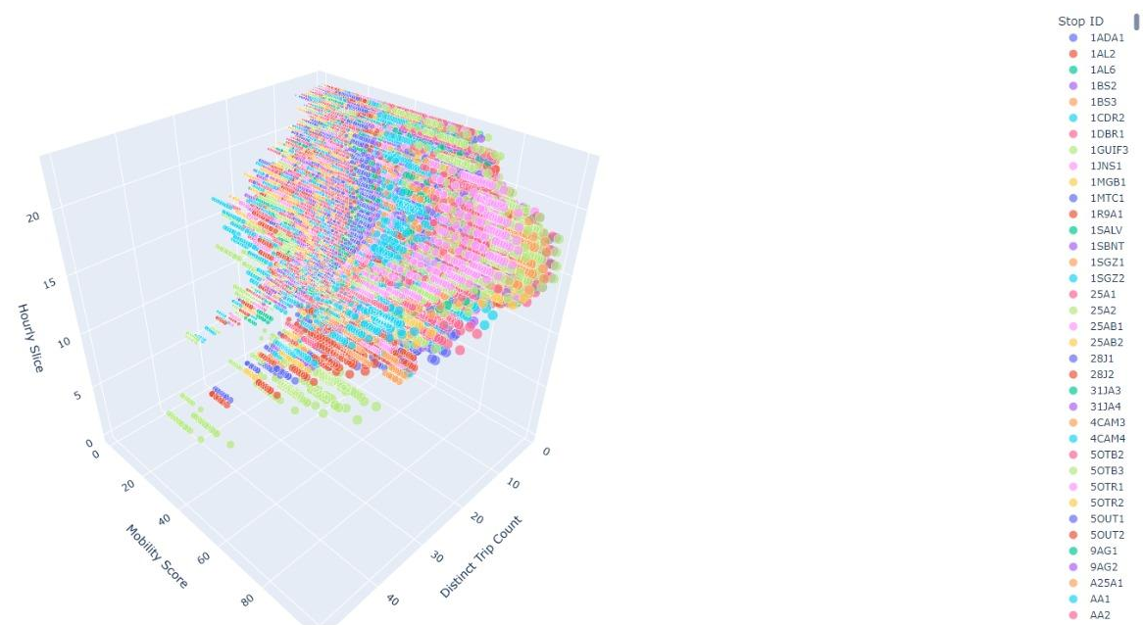
Impact & Opportunities
Identifying sub-optimal availability of bus trips per bus stops in an hourly slice

Slide 12



Future Work/Next Steps
Current Mobility score is computed solely on WiFi Access
Non PII Financial transaction data in order to predict the “mobility score” with higher accuracy.
Transit traffic flow data in order to help to better predict the “mobility score” index.

Slide 13



Conclusion
"Analytical solutions must prioritize privacy when processing PII data, ensuring they can generate valuable insights while safeguarding citizens security and maintaining compliance with common law."

Slide 14
Thank you!

